Slide 1
Refactoring Example and Extract Method

Slide 2
Switch Statement
`switch` statements always lead to very long methods, dozens of conditions and every instruction requires at least few lines of code plus break.Robert C Martin in his book “Clean Code” says that method “Should be as small as possible”

Slide 3
Replace Conditional with Polymorphism
Switch statements are often considered code smells and should be avoided
Problem
You have a conditional that performs various actions depending on object type or properties.
Solution
Create subclasses matching the branches of the conditional. In them, create a shared method and move code from the corresponding branch of the conditional to it. Then replace the conditional with the relevant method call. The result is that the proper implementation will be attained via polymorphism depending on the object class.

Slide 4
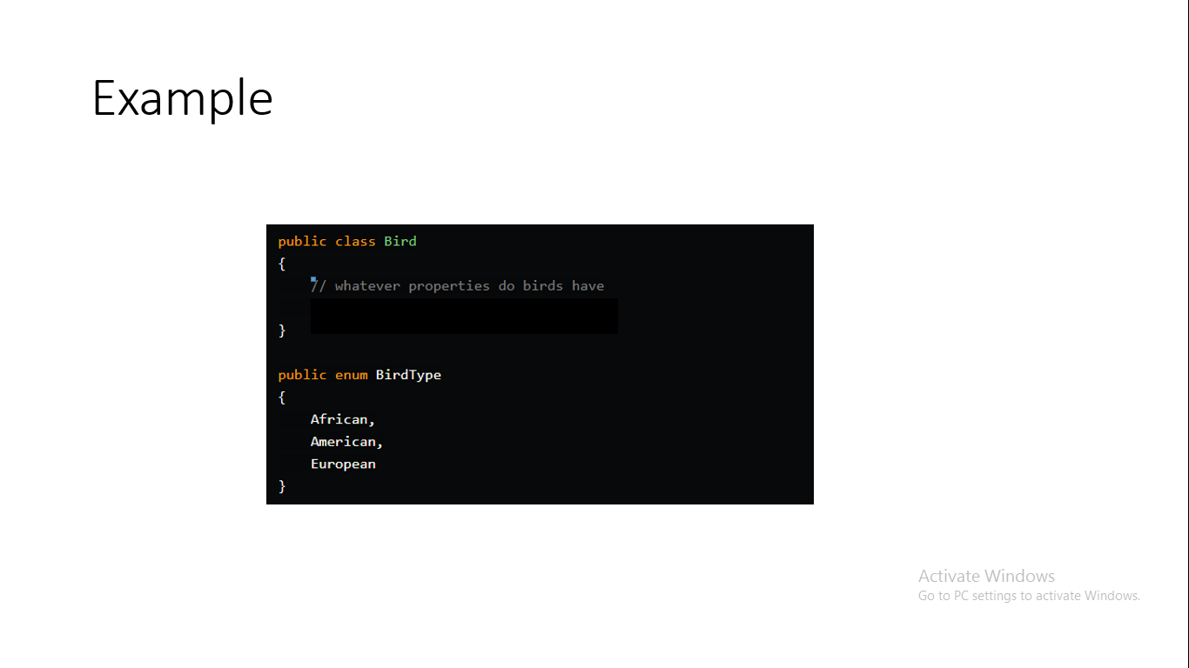

Slide 5
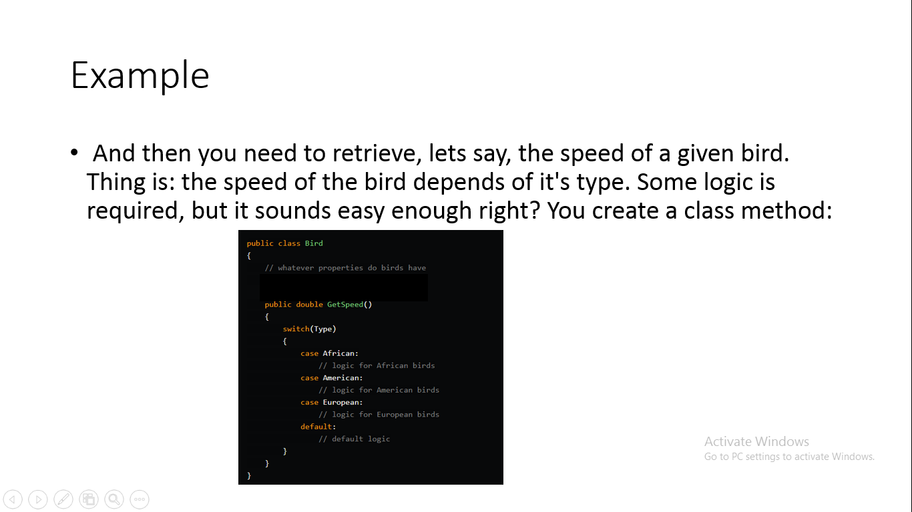

Slide 6
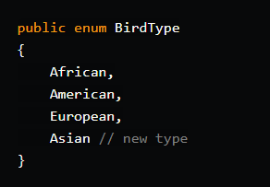
Example
A little bit ugly, but it gets the job done right? But here's the catch: after some time in production, you need to add a new type of bird, lets say Asian
And now you have to calculate it's speed as well. "Just add another case to the switch statement" you might say.

Slide 7
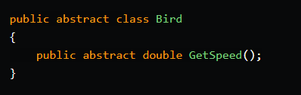
The Solution: Polymorphism
With Object-Oriented Programming we have the concept of inheritance and, with that, we can implement polymorphism.
We start very much the same, Defining the bird class but with one change

Slide 8
The Solution
Now we have added the abstract modifier to GetSpeed Method and the Bird class itself.
What that means is that Bird Class itself has no implementation for that method,nor can be instantiated and any subclass might implement it .

Slide 9
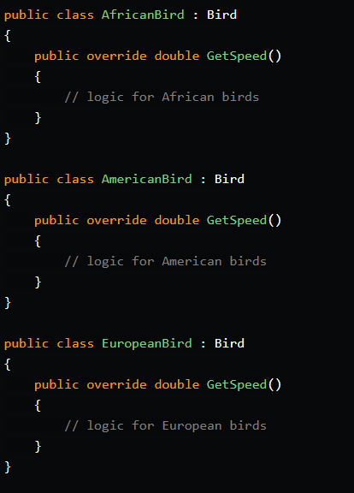

Slide 10
Refactoring Extract Method
“Extract Method Refactoring” is intended for “a code fragment that can be grouped together”
Refactoring turns this fragment into a method whose name explains the purpose of method

Slide 11
To put it plainly, “Extract Method” means extraction of a part of existing method as a new method, and the extracted part is replaced by a new method caller
In general, this pattern is applied to the case that there is a too long method.
In applying the pattern to code clones, a new method, that is a code fragment of code clone, is defined and the original code clones are replaced by the new method caller. As a result, we can modify the code clones

Slide 12
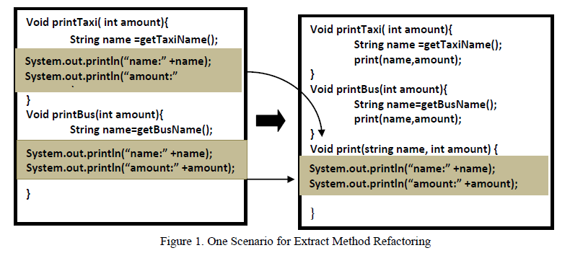
Extract Method Refactoring

